Slide 1
Hypothesis Testing
© 2019 Tata Insights and Quants Division. All Rights Reserved.
TataiQ_Internal

Slide 2
© 2019 Tata Insights and Quants Division. All Rights Reserved.
TataiQ_Internal

Slide 3
Outline
Introduction
Steps of hypothesis test
One-tailed vs. two-tailed test
  p-Value Approach to One-Tailed Hypothesis Testing
  Critical Value Approach to One-Tailed Hypothesis Testing
  p-Value Approach to Two-Tailed Hypothesis Testing
  Critical Value Approach to Two-Tailed Hypothesis Testing
p-value Determination
Example of hypothesis test
Errors in Hypothesis Testing
Measuring Effect Size
Power of a Hypothesis Test
Public
Confidential/ Client Confidential/ Proprietary & Confidential/ Internal
© 2018 Tata Insights and Quants Division. All Rights Reserved.

Slide 4
Introduction
The general goal of a hypothesis test is to rule out chance (sampling error) as a plausible explanation for the results from a research study.
Hypothesis testing can be used to determine whether a statement about the value of a population parameter should or should not be rejected.
The null hypothesis, denoted by H₀ , is a tentative assumption about a population parameter.
The alternative hypothesis, denoted by H₁, is the opposite of what is stated in the null hypothesis.
The hypothesis testing procedure uses data from a sample to test the two competing statements indicated by H₀ and H₁.
Public
Confidential/ Client Confidential/ Proprietary & Confidential/ Internal
© 2018 Tata Insights and Quants Division. All Rights Reserved.

Slide 5
Steps of Hypothesis Test
Choosing a test statistic
Define the null hypothesis, H₀ and alternate hypothesis, H₁
Select significance level i.e. α to reject the null hypothesis
Collect the sample data and compute the value of the test statistic, TS_{CAL}.
p-value Approach
  Use the value of the test statistic to compute the p-value.
  Reject H₀ if p-value < α
Critical value Approach
  Determine critical value of test statistic, TS_{CR}
  Determine if TS_{CR} falls into (Non) Rejection Region
Formulate H₀ and H₁
Select Appropriate Test
Choose Level of Significance, α
Calculate Test Statistic TS_{CAL}
Determine Prob Associated with Test Statistic
Determine Critical Value of Test Stat,
TS_{CR}
Compare with Level of Significance, α
Determine if TS_{CR}
falls into (Non) Rejection Region
Middle 95%: High Probability Values
If H₀ is true.
Reject/Do not Reject H₀
Critical region: Extreme 5%
Draw the conclusion
Public

Slide 6
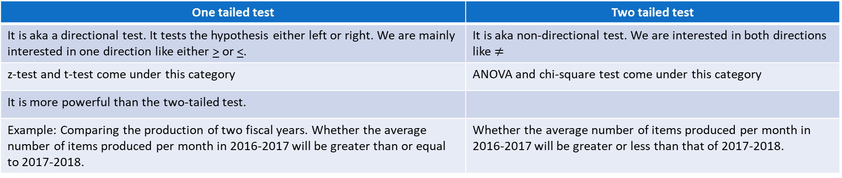
One tailed test vs. two tailed test
In one tailed test, we check whether the score of group A is significantly > the score of group B or the score of group A is significantly < the score of group B.
In two tailed test, we check whether the score of group A is significantly greater or less than the score of group B.
One tailed test | Two tailed test
It is aka a directional test. It tests the hypothesis either left or right. We are mainly interested in one direction like either > or <. | It is aka non-directional test. We are interested in both directions like $≠$
z-test and t-test come under this category | ANOVA and chi-square test come under this category
It is more powerful than the two-tailed test.
Example: Comparing the production of two fiscal years. Whether the average number of items produced per month in 2016-2017 will be greater than or equal to 2017-2018. | Whether the average number of items produced per month in 2016-2017 will be greater or less than that of 2017-2018.
Lower tail test: H₀ : µ₀ < µ, H₁ : µ₀ > µ
Upper tail test: H₀ : µ₀ > µ, H₁ : µ₀ < µ
Two tailed test: H₀ : µ = µ_{0,} H₁ : µ ≠ µ₀
α
µ₀
µ
µ
µ₀
µ
Lower tail test
Upper tailed test
α/2
Two tailed test
α/2
α
Public

Slide 7
p-Value Approach to One-Tailed Hypothesis Testing
The p-value is the probability, computed using the test statistic, that measures the support (or lack of support) provided by the sample for the null hypothesis.
If the p-value is less than or equal to the level of significance α, the value of the test statistic is in the rejection region.
Reject H₀ if the p-value < α.
Interpretation of p-values
Less than .01
  Overwhelming evidence to conclude H₁ is true.
Between .01 and .05
  Strong evidence to conclude H₁ is true.
Between .05 and .10
  Weak evidence to conclude H₁ is true.
Greater than .10
  Insufficient evidence to conclude H₁ is true.
α
Public

Slide 8
Critical Value Approach to One-Tailed Hypothesis Testing
The test statistic z has a standard normal probability distribution.
We can use the standard normal probability distribution table to find the z-value with an area of α in the lower (or upper) tail of the distribution.
The value of the test statistic that established the boundary of the rejection region is called the critical value for the test.
The rejection rule is:
  Lower tail: Reject H₀ if z < -z_{α}
  Upper tail: Reject H₀ if z > z_{α}
Public

Slide 9
Example of One-Tailed Hypothesis Testing
Ex. In a Metro Emergency Medical System (EMS), the response times for a random sample of 40 medical emergencies were tabulated. The sample mean is 13.25 minutes. The population standard deviation is believed to be 3.2 minutes. The EMS director wants to perform a hypothesis test, with a .05 level of significance, to determine whether the service goal of 12 minutes or less is being achieved.
Step 1: Develop the hypotheses.
Step 2. Specify the level of significance.
Step 3. Compute the value of the test statistic.
P-value approach:
Step 4. Compute the p –value.
H₀: μ < 12
H_{a}: μ > 12
α = .05
α = .05
p-value
= .0068
z
For z = 2.47, cumulative probability = .9932.
p–value = 1 − .9932 = .0068
z =
2.47
0
Public

Slide 10
Example of One-Tailed Hypothesis Testing
Step 5. Determine whether to reject H₀.
Because p–value = .0068 < α = .05, we reject H₀.
Hence, there is sufficient statistical evidence to infer that Metro EMS is not meeting the response goal of 12 minutes.
Critical value approach:
Step 4. Determine the critical value and rejection rule.
Sampling
distribution
of
α = .05
For α = .05, z_{.05} = 1.645
Reject H₀ if z > 1.645
p-value
= .0068
Step 5. Determine whether to reject H₀.
Because 2.47 > 1.645, we reject H₀.
z
0
z_{α} =
1.645
z =
2.47
Hence, there is sufficient statistical evidence to infer that Metro MS is not meeting the response goal of 12 minutes.
Public

Slide 11
Two-Tailed Hypothesis Testing
p-Value Approach to Two-Tailed Hypothesis Testing
Compute the p-value using the following three steps:
  Compute the value of the test statistic z.
  If z is in the upper tail (z > 0), compute the probability that z is greater than or equal to the value of the test statistic. If z is in the lower tail (z < 0), compute the probability that z is less than or equal to the value of the test statistic.
  Double the tail area obtained in step 2 to obtain the p–value.
The rejection rule: Reject H₀ if the p-value < α.
Critical Value Approach to Two-Tailed Hypothesis Testing
The critical values will occur in both the lower and upper tails of the standard normal curve.
Use the standard normal probability distribution table to find z_{α/2} (the z-value with an area of α/2 in the upper tail of the distribution).
The rejection rule: Reject H₀ if z < -z_{α/2} or z > z_{α/2}.
α/2
α/2
Public

Slide 12
Example of Two-Tailed Hypothesis Testing
Ex. The production line for Glow toothpaste is designed to fill tubes with a mean weight of 6 oz.
Periodically, a sample of 30 tubes will be selected in order to check the filling process. Quality assurance procedures call for the continuation of the filling process if the sample results are consistent with the assumption that the mean filling weight for the population of toothpaste tubes is 6 oz.; otherwise the process will be adjusted.
Assume that a sample of 30 toothpaste tubes provides a sample mean of 6.1 oz. The population standard deviation is believed to be 0.2 oz. Perform a hypothesis test, at the .03 level of significance, to help determine whether the filling process should continue operating or be stopped and corrected.
Step 1: Develop the hypotheses.
Step 2. Specify the level of significance.
Step 3. Compute the value of the test statistic.
H₀: μ = 6
H_{a}:
α = .03
Public

Slide 13
Example of Two-Tailed Hypothesis Testing
P-value approach:
Step 4. Compute the p –value.
For z = 2.74, cumulative probability = .9969
p–value = 2(1 − .9969) = .0062
Step 5. Determine whether to reject H₀.
Because p–value = .0062 < α = .03, we reject H₀.
There is sufficient statistical evidence to infer that the alternative hypothesis is true (i.e. the mean filling weight is not 6 ounces).
1/2
p -value
= .0031
1/2
p -value
= .0031
α/2 =
.015
α/2 =
.015
z
z = -2.74
0
z = 2.74
-z_{α/2} = -2.17
z_{α/2} = 2.17
Public

Slide 14
Example of Two-Tailed Hypothesis Testing
Critical value approach:
Step 4. Determine the critical value and rejection rule.
For α/2 = .03/2 = .015, z_{.015} = 2.17
Reject H₀ if z < -2.17 or z > 2.17
Step 5. Determine whether to reject H₀.
Because 2.74 > 2.17, we reject H₀.
There is sufficient statistical evidence to infer that the alternative hypothesis is true (i.e. the mean filling weight is not 6 ounces).
Public

Slide 15
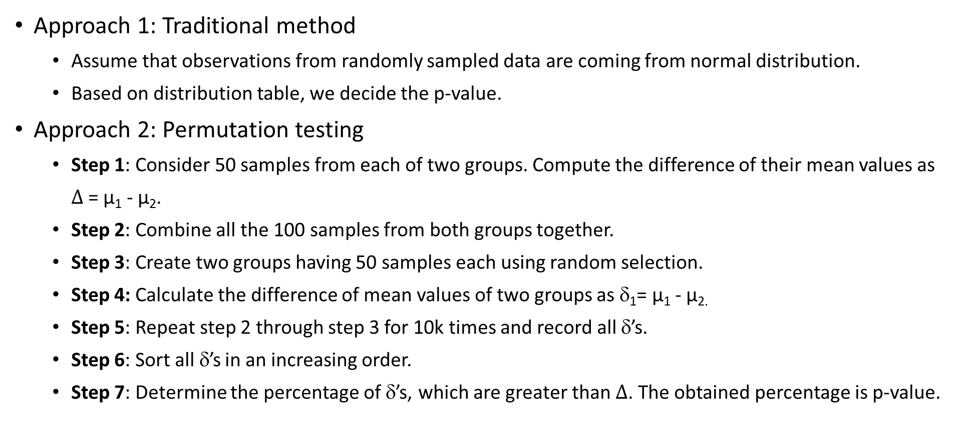
p-value Determination
Approach 1: Traditional method
  Assume that observations from randomly sampled data are coming from normal distribution.
  Based on distribution table, we decide the p-value.
Approach 2: Permutation testing
  Step 1: Consider 50 samples from each of two groups. Compute the difference of their mean values as $∆$= µ₁ - µ₂.
  Step 2: Combine all the 100 samples from both groups together.
  Step 3: Create two groups having 50 samples each using random selection.
  Step 4: Calculate the difference of mean values of two groups as δ₁= µ₁ - µ_{2.}
  Step 5: Repeat step 2 through step 3 for 10k times and record all δ’s.
  Step 6: Sort all δ’s in an increasing order.
  Step 7: Determine the percentage of δ’s, which are greater than $∆$. The obtained percentage is p-value.
Public

Slide 16
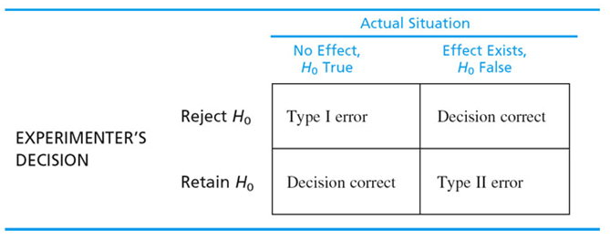
Errors in Hypothesis Tests
There might be some discrepancy between a sample mean and the population mean simply as a result of sampling error.
Because the hypothesis test relies on sample data, and because sample data are not completely reliable, there is always the risk that misleading data will cause the hypothesis test to reach a wrong conclusion.
In such cases, two types of error are possible.
Type II Errors
A Type II error is accepting H₀ when it is false.
Type II errors are commonly the result of a very small change in the mean value.
It is difficult to control for the probability of making a Type II error.
Statisticians avoid the risk of making a Type II error by using “do not reject H0” and not “accept H0”.
Type I Errors
A Type I error is rejecting H₀ when it is true i.e. false positive error.
Type I errors are caused by unusual, unrepresentative samples. Just by chance the researcher selects an extreme sample with the result that the sample falls in the critical region.
The probability of making a Type I error when the null hypothesis is true as an equality is called the level of significance.
Applications of hypothesis testing that only control the Type I error are often called significance tests.
Public
Confidential/ Client Confidential/ Proprietary & Confidential/ Internal
© 2018 Tata Insights and Quants Division. All Rights Reserved.

Slide 17

Measuring effect size
A hypothesis test evaluates the statistical significance of the results from a research study.
That is, the test determines whether or not it is likely that the obtained sample mean occurred without any change in distribution.
The hypothesis test is influenced not only by the change in distribution but also by the size of the sample.
Thus, even a very small effect can be significant if it is observed in a very large sample.
Because a significant effect does not necessarily mean a large effect, it is recommended that the hypothesis test be accompanied by a measure of the effect size.
Cohen measures the size of the mean difference in terms of the standard deviation.
Suppose we assume that μ represents the mean of the population of interest and μ₀ represents a value to which the mean is to be compared. If the standard deviation is σ, the effect size is represented by d where
$$d=\frac{μ−μ_{0}}{σ}$$
Cohen (1988) proposed the following interpretation of the d values. A d near 0.2 is a small effect, a d near 0.5 is a medium effect, and a d near 0.8 is a large effect.
These values for small, medium, and large effects are popular in the social sciences. However, this convention is not as popular among the medical sciences since the scale of the effect is left unstated which makes interpretation difficult.
Public

Slide 18
Power of a Hypothesis Test m
The probability of correctly rejecting H₀ when it is false (i.e. Type II error) is called the power of the test.
For any particular value of µ, the power is 1 – β, where β is type II error.
We can show graphically the power associated with each value of µ; such a graph is called a power curve as depicted in the figure.
When the true population mean μ is close to the null hypothesis value of μ =120, the probability is high that we will make a Type II error.
However, when the true population mean μ is far below the null hypothesis value of μ = 120, the probability is low that we will make a Type II error.
Public
Confidential/ Client Confidential/ Proprietary & Confidential/ Internal
© 2018 Tata Insights and Quants Division. All Rights Reserved.

Slide 19
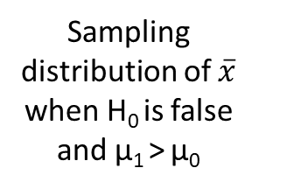





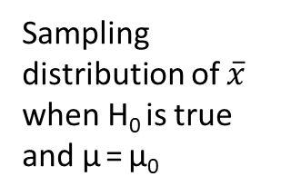

Determining the Sample Size for a Hypothesis Test About a Population Mean
Assume that a hypothesis test is to be conducted about the value of a population mean.
The specified level of significance determines the probability of making a Type I error.
By controlling the sample size, the probability of making a Type II error can be controlled.
Sampling distribution of $\overline{x}$ when H₀ is true and µ = µ₀
c
H₀: µ < µ₀
H₁: µ > µ₀
Note: $σ_{\overline{x}}$= $\frac{σ}{\sqrt{n}}$
α
$$c= μ_{0}+z_{α}\frac{σ}{\sqrt{n}}$$
(1)
$\overline{x}$
µ₀
Sampling distribution of $\overline{x}$ when H₀ is false and µ₁ > µ₀
$$c= μ_{1}−z_{β}\frac{σ}{\sqrt{n}}$$
(2)
n= $\frac{{{(z}_{α}+z_{β})}^{2}σ^{2}}{{{(μ}_{0}−μ_{1})}^{2}}$
(3)
β
Where
z_{α} = z value providing an area of α in the tail
z_{β} = z value providing an area of β in the tail
σ = population standard deviation
µ₀ = value of the population mean in H₀
µ₁ = value of the population mean used for the Type II error
µ₁
$\overline{x}$
Observations
For a given sample size, choosing a smaller level of significance means more exposure to a Type II error.
Inexperienced users of hypothesis testing often think that smaller values of α are always better. They are better if we are concerned only about making a Type I error.
Public
Confidential/ Client Confidential/ Proprietary & Confidential/ Internal
© 2018 Tata Insights and Quants Division. All Rights Reserved.

Slide 20
References
Anderson, Sweeney, Williams, Camm, Cochran, Statistics for Business and Economics, 12e
https://home.ubalt.edu/tmitch/631/631.htm

Slide 21
© 2019 Tata Insights and Quants Division. All Rights Reserved.
TataiQ_Internal

